Slide 1

Final Group Project
FilmTV Movies Dataset
By: Sam Anteneh, Kathlyne Alilain, Jasmine Carvalho, Christian Perez, Jorge Servin

Slide 2
Agenda
Introduction
Related Work
Dataset Overview
Data Implementation & Analysis
Conclusion

Slide 3
Introduction
Purpose: Explore movie data to uncover insights into audience preferences and trends.
Dataset: FilmTV dataset with details on 41,000+ films (e.g., genre, ratings, votes).
Goal: Identify patterns that inform filmmaking and distribution decisions.
Tools: Elasticsearch for data classification and Kibana for visualization (e.g., bar graphs, pie charts).
Importance: Helps manage extensive data and supports better decision-making in filmmaking and distribution.

Slide 4
Related Work
The paper Movie Dataset Analysis Using Hadoop-Hive explores the use of Hadoop and Hive for analyzing large-scale movie datasets. It demonstrates how Hadoop provides scalability and efficiency in handling big data, while Hive enables structured querying of the datasets. The study emphasizes the effectiveness of this combination for big data analytics in the context of movie-related data, showcasing its potential for handling complex queries and generating insights efficiently.
Notes:
The paper survey on movie data analysis covers various methods used to analyze movie data and their usefulness, Movie Dataset Analysis Using Hadoop-Hive explores the use of Hadoop and Hive for analyzing large-scale movie datasets. It demonstrates how Hadoop provides scalability and efficiency in handling big data, while Hive enables structured querying of the datasets. The study emphasizes the effectiveness of this combination for big data analytics in the context of movie-related data, showcasing its potential for handling complex queries and generating insights efficiently.
However, our work builds on and diverges from this approach by leveraging the unique capabilities of Elasticsearch and Kibana. Unlike Hadoop-Hive, which primarily focuses on batch processing and structured querying, Elasticsearch offers near-instantaneous indexing and searching capabilities, making it more suited for real-time data analysis. It also provides an interactive way to explore data trends, which is less emphasized in the Hadoop-Hive framework.
Our work will extend the concepts of scalability and structured analysis by addressing the need for dynamic, real-time insights. Additionally, our integration of machine learning within Elasticsearch allows us to not only analyze historical data but also predict trends, such as average movie ratings, providing an additional layer of value that Hadoop-Hive does not explicitly cover.

Slide 5
Dataset Overview/Background
Movie dataset is 27mb which contains 41,000 movie records across 19 attributes
Traditional methods for analyzing movie data often depend on static databases and manual searches (IMDb or Rotten Tomatoes)
Elasticsearch offers fast, scalable search capabilities, handling our 27MB dataset efficiently by indexing data for near-instantaneous search and aggregation
Advantages that static databases struggle to match due to structural limitations and slower read speeds.
https://www.kaggle.com/datasets/stefanoleone992/filmtv-movies-dataset

Slide 6
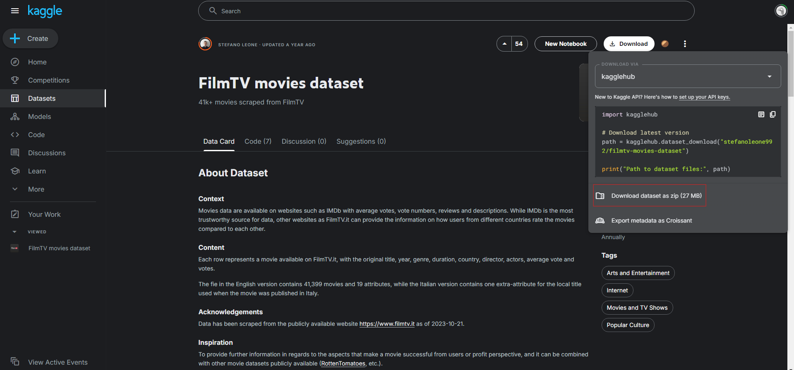
Data Implementation and Analysis
Step 1 - Download the Dataset
Visit Kaggle and download the CSV file for the FilmTV dataset.
Save the dataset locally for analysis.
Notes:
In this first step, we focused on obtaining the dataset we would use for our analysis and machine learning tasks. The dataset was sourced from Kaggle, a well-known platform for hosting a wide variety of datasets. Specifically, we used the FilmTV dataset, which contains detailed information on over 41,000 movies. To download the dataset, we visited the FilmTV Movies Dataset page on Kaggle, where we accessed the file by clicking the download button. The dataset is in a structured CSV format, which is ideal for preprocessing and ingestion into ElasticSearch. Once downloaded, we saved the dataset locally in our working directory to ensure it was readily accessible for the next steps.

Slide 7
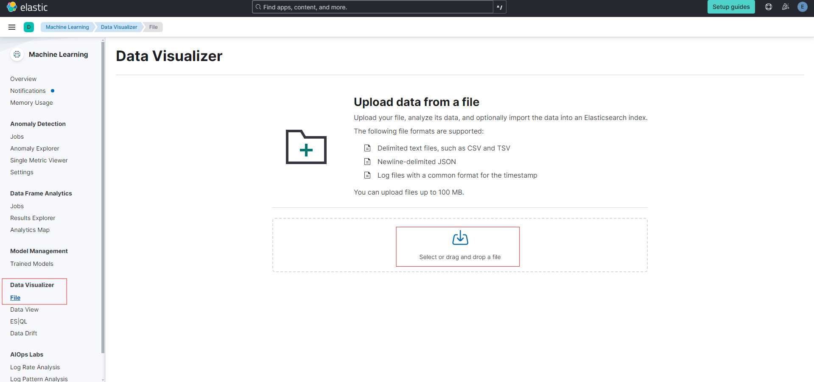
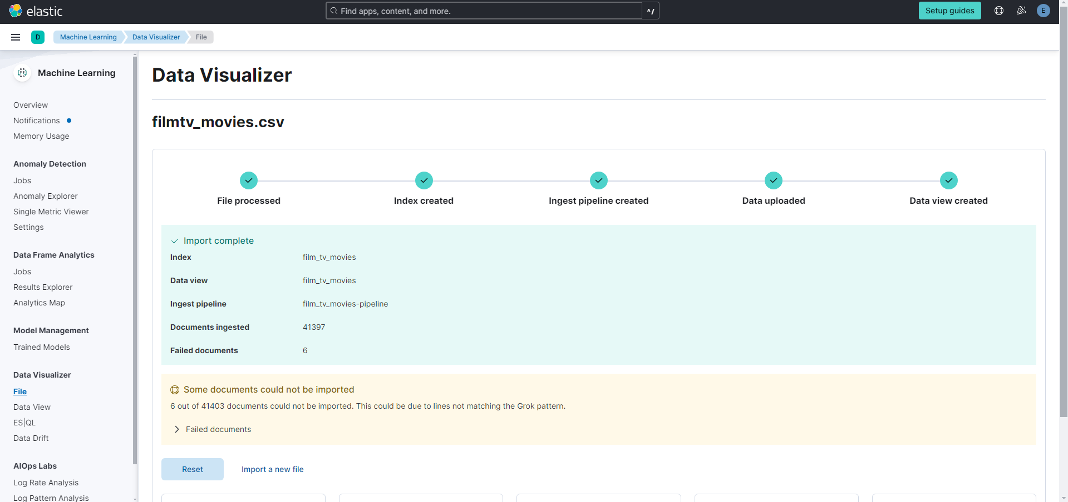
Data Implementation and Analysis
Step 2 - Load Dataset in ElasticSearch
Log in to Elastic Cloud.
Use Kibana Data Visualizer to upload the CSV file.
Confirm data structure and create the index film_tv_movies.
Outcome: Dataset indexed and ready for analysis.
Notes:
In Step 2, the focus is on getting the dataset into ElasticSearch so we can start analyzing it. First, we logged into Elastic Cloud. After logging in, we navigated to Kibana. From Kibana, we accessed the Data Visualizer tool, which is specifically designed to make it easy to upload structured data like the CSV file we downloaded in Step 1. Once we selected the CSV file, Kibana automatically detected its structure and displayed a preview of the data, allowing us to confirm that it had been properly interpreted. At this point, we created a new index named film_tv_movies, which would store all the data from the CSV file in an organized and searchable format. By confirming the data structure and creating the index, we ensured that the dataset was properly ingested into ElasticSearch. The outcome of this step was that the dataset was indexed and now ready for analysis.

Slide 8
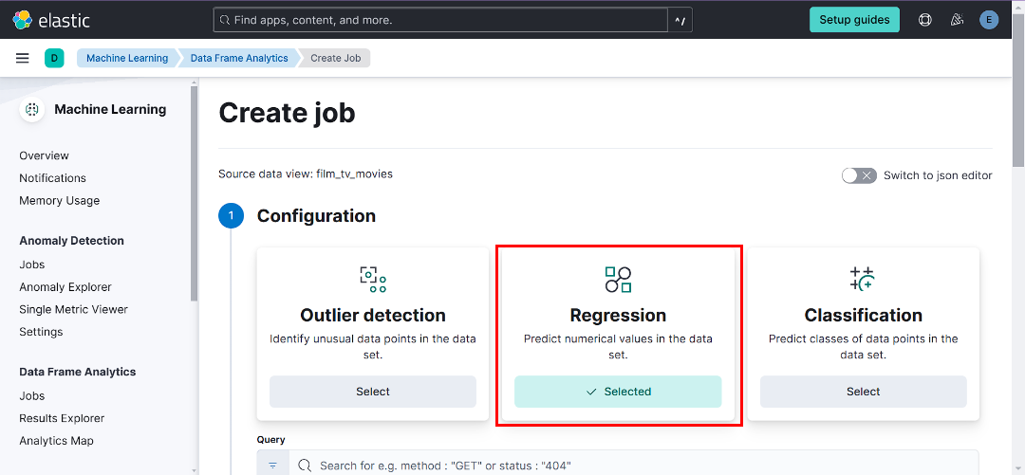
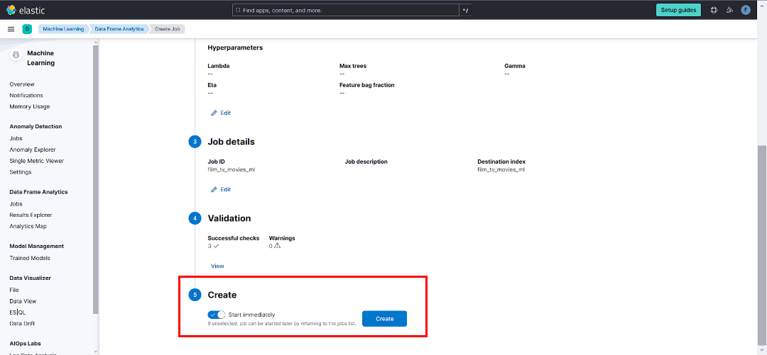
Data Implementation and Analysis
Step 3 - Create a Machine Learning Job
Goal: Predict average movie ratings (avg_vote).
Steps:
Navigate to Machine Learning > Data Frame Analytics in Kibana.
Select Regression and set avg_vote as the dependent variable.
Include fields: duration, critics_vote, total_votes, year, public_vote, and genre.
Set Job ID: film_tv_movies_ml.
Review and run the job.
Notes:
In Step 3, our goal was to create a machine learning job in Kibana to predict average movie ratings based on various movie attributes. To begin, we navigated to the Machine Learning section in Kibana and then selected Data Frame Analytics, which is where we configure and run machine learning jobs on our dataset. From there, we selected the Regression model type, as we were predicting a continuous value which is movie ratings.
Next, we set the dependent variable to avg_vote, since that is the target value we want to predict. We then chose several independent variables to include in the model: duration, critics_vote, total_votes, year, public_vote, and genre. These features were selected because they are likely to have a significant impact on how a movie is rated, based on factors such as movie length, audience reception, and popularity.
We also specified a Job ID, which we named film_tv_movies_ml, to uniquely identify this machine learning job in the system. After reviewing the job configuration, we created and ran the job. This triggered the machine learning model to start processing the dataset, learning from the relationships between the selected features and the average movie ratings. With this step, we now had a trained regression model that was ready to evaluate its predictive performance.

Slide 9
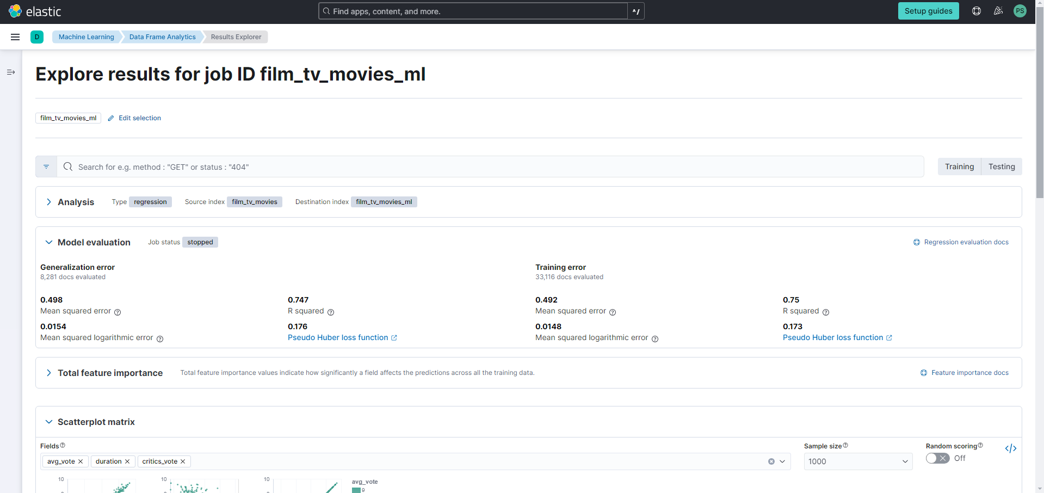
Data Implementation and Analysis
Step 4 - Evaluate Model Performance
Check Metrics:
Root Mean Squared Error (RMSE).
R² (Coefficient of Determination).
Scatterplot Matrix.
Interpretation:
MSE: 0.498
R²: 0.747
Notes:
In Step 4, the focus is on evaluating the performance of our regression model, which we created in the previous step. To assess how well the model is predicting average movie ratings we looked at several key metrics that provide insight into its accuracy. The first metric we checked is the Root Mean Squared Error (RMSE).. A lower RMSE value indicates better model performance, as it means the predicted ratings are closer to the true ratings.
Next, we examined the R² (Coefficient of Determination), which I will go into depth in the next slide
We also looked at the scatterplot matrix, which visually shows the correlation between actual and predicted values, as well as how well the model fits the data

Slide 10
Data Implementation and Analysis
Model Performance Analysis
Model's results provide key insights into how well it predicts avg_vote based on the features we selected for the ML Job.
1. Mean Squared Error (MSE): 0.498
MSE measures the average squared difference between the predicted and actual avg_vote values.
A value of 0.498 indicates that the predictions are relatively close to the actual ratings, with small average errors.
2. R² (R-squared): 0.747
R² represents the proportion of variance in the target variable avg_vote that is explained by the model.
A value of 0.747 means that 74.7% of the variability in avg_vote is accounted for by the selected features.
Notes:
In this slide, we’re diving into the results of our model and interpreting its performance based on two key metrics: Mean Squared Error (MSE) and R² (R-squared). These metrics provide insights into how accurately the model predicts the average movie ratings (avg_vote) and how much of the variability in those ratings is explained by the features we selected.
First, Mean Squared Error (MSE) is 0.498. MSE measures the average squared difference between the predicted avg_vote values and the actual values. Essentially, it tells us how far off, on average, the model’s predictions are from the true values. A value of 0.498 indicates that the model’s predictions are relatively close to the actual ratings, with relatively small average errors. This is a good result, showing that the model is performing well and accurately predicting ratings in most cases.
Next, R² (R-squared) is 0.747. R² represents the proportion of the variance in avg_vote that is explained by the model. In other words, it tells us how much of the variability in movie ratings can be attributed to the features we included in the model,. With an R² of 0.747, we know that 74.7% of the variance in movie ratings is accounted for by these features, which is a solid result. It means the model is capturing important relationships in the data, although there's still room for improvement.
These two metrics together show that our model does a good job predicting movie ratings but still has some areas that could be optimized, particularly in accounting for the unexplained variance.

Slide 11
Data Implementation and Analysis
Model Performance Challenges
Adding more relevant attributes could improve predictions.
At 27 MB and 41,000 records, the dataset may lack diversity and depth for training a robust model.
The dataset did not include location data (e.g. coordinates) in a format compatible with Kibana mapping features which did not allow us to create a tempo-spatial analysis
Notes:
In this slide, we address some of the challenges we faced during the model’s development and evaluation. While the model performed reasonably well, there are several areas that could be improved to boost its accuracy.
First, adding more relevant attributes could enhance the model’s predictions. For instance, including features like director reputation, movie budget could provide additional insights into movie ratings. These features are likely to have a significant impact but were not part of the dataset, which could explain some of the unexplained variance in our model.
Second, the dataset size is a bit small. With a size of 27 MB and 41,000 records, the dataset is relatively small compared to large-scale industry datasets. This lack of depth means the model might not generalize well to other movie data or capture all potential nuances of movie ratings. A larger and more diverse dataset would likely improve the model’s predictive power.
Lastly, missing location data posed a challenge. We initially intended to create a tempo-spatial analysis, which involves both time and geographic location. However, the dataset lacked location data in a format compatible with Kibana’s mapping features, such as geo-coordinates. Without proper location data, we were unable to build the intended maps or analyze how ratings vary geographically or over time, limiting the scope of our analysis.
These challenges highlight areas where the model can be improved by enhancing the dataset and exploring additional features, allowing for better predictions and richer insights.

Slide 12
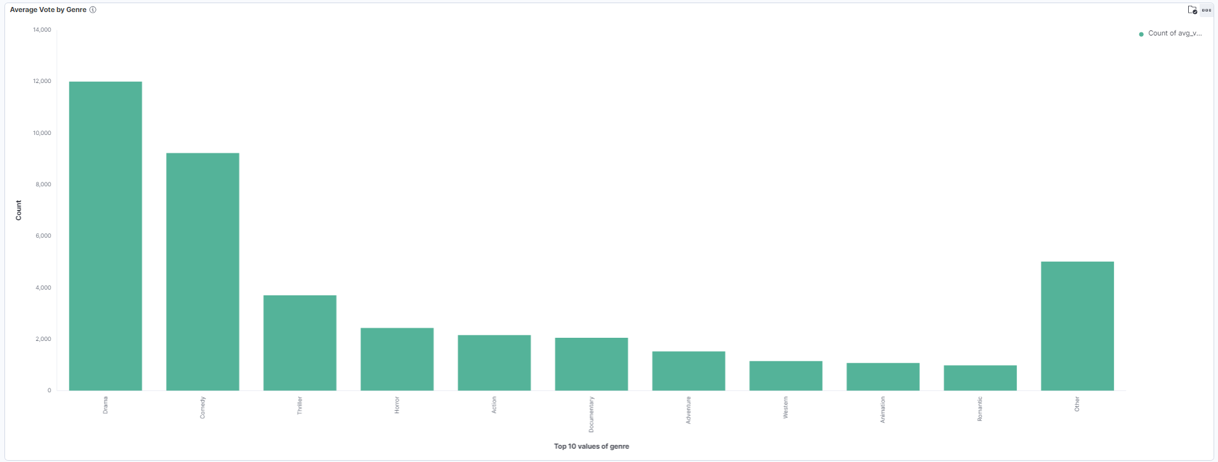
Average Vote by Genre
This chart shows the average movie ratings across different genres.
Data Implementation & Analysis (Bar Chart)
Notes:
In this slide, we present the Average Vote by Genre chart, which provides valuable insights into how movies are rated across different genres. The chart visualizes the average movie ratings (avg_vote) for various genres in our dataset. By analyzing this chart, we can observe trends that highlight which genres tend to receive higher ratings from audiences.
For example, genres like Drama and Comedy have higher average ratings due to their broad appeal or emotional impact, while genres like Documentary or Romantic might show more variation in ratings. This chart helps us understand audience preferences and can guide filmmakers, studios, and distributors in making decisions about movie production and marketing.
The key takeaway from this visualization is how different genres resonate with audiences, which is useful not only for predicting movie ratings but also for identifying patterns and preferences across genres. By examining these differences, we can make more informed predictions about future movie performance and trends.

Slide 13
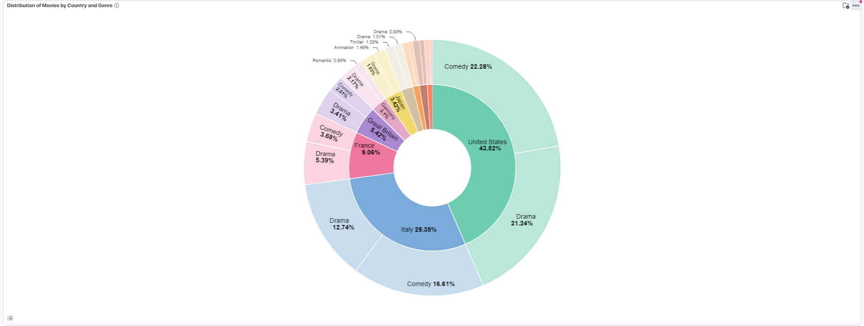
Distribution of Movies by Country and Genre
The outer pie chart shows the distribution of genres within each country, and the inner pie chart shows the distribution of movies by country.
Data Implementation & Analysis (Pie Chart)
Notes:
In this slide, we present the Distribution of Movies by Country and Genre, which is visualized using a pie chart with two layers. The outer pie chart shows the distribution of genres within each country, while the inner pie chart displays the distribution of movies by country.
The inner pie chart highlights the proportion of movies produced in different countries, giving us a clear picture of the global movie production landscape. For instance, we might see that countries like the United States or Italy dominate the production of films, while other countries may have a smaller representation.
The outer pie chart adds another layer of insight by showing the distribution of genres within each country. This allows us to compare how genres like Comedy, or Drama are distributed across countries. For example, certain countries may have a higher concentration of Comedy movies, while others might focus more on other films. This chart helps us understand both global movie production trends and the genre preferences that vary across different regions.
By using this visualization, we can better understand how movie genres are represented globally and regionally, and this could inform decisions related to film distribution and marketing strategies in various countries.

Slide 14
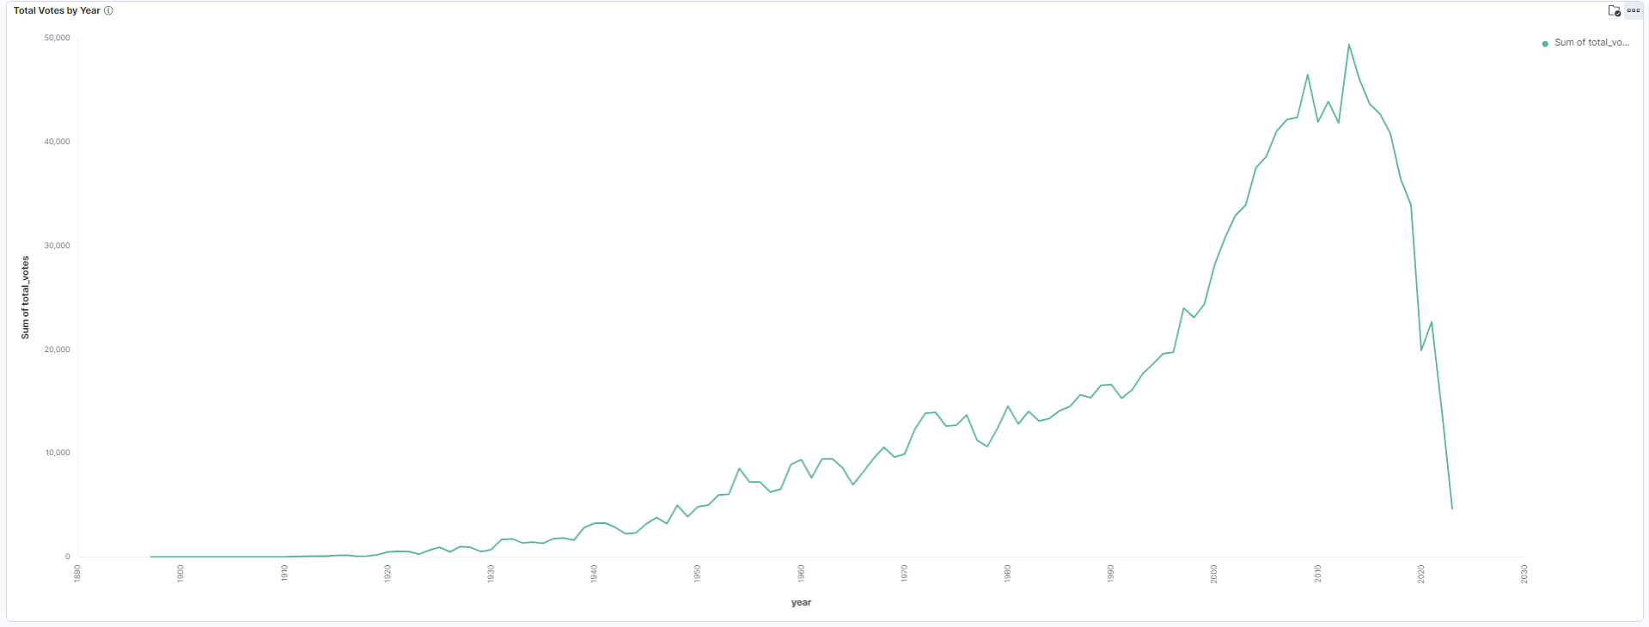
Total Votes by Year
This chart visualizes the trend of total votes received by movies per year.
Data Implementation & Analysis (Line Chart)
Notes:
In this slide, we visualize the trend of total votes received by movies per year. The chart shows how the number of votes has changed over time, allowing us to observe patterns in audience engagement with movies.
By examining this chart, we can identify key trends, such as periods where movie ratings and votes surged, possibly due to the release of blockbuster films. For instance, we may see higher vote counts in recent years, reflecting the rise of online platforms like Netflix, Hulu and Rotten Tomatoes, where audience participation has become more accessible.
This chart provides insights into how movie popularity, as reflected by voting activity, has evolved over time. The increase in total votes could also indicate growing global interest in movies, as more audiences have access to online platforms for rating films. This type of trend analysis is valuable for understanding the shifts in movie consumption and audience behavior over the years.

Slide 15
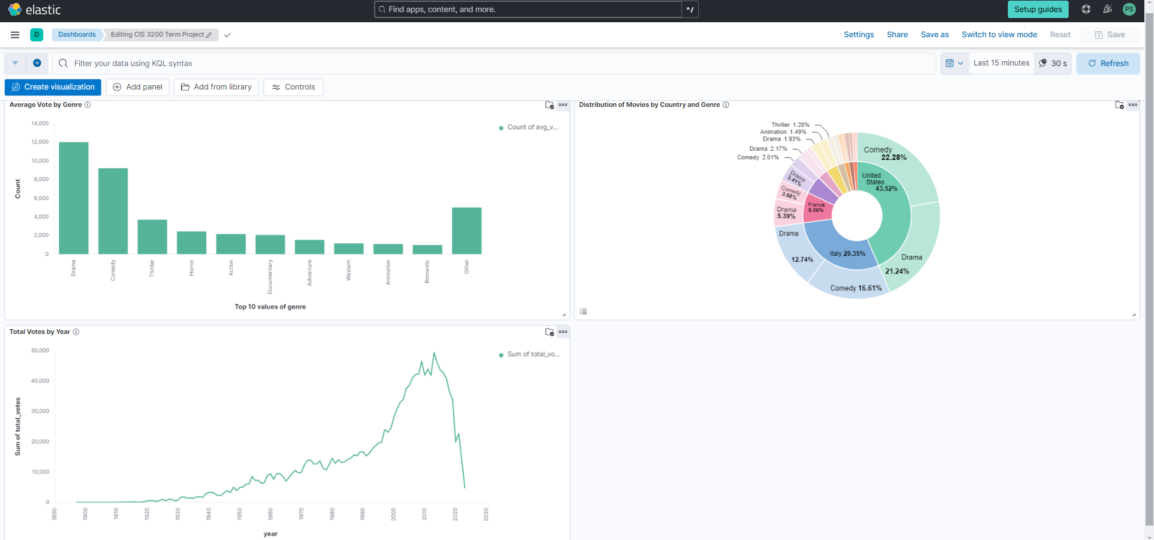
Dashboard
Data Implementation & Analysis

Slide 16
Conclusion
Analyzed movie dataset (41,000+ records) using Elasticsearch and Kibana.
Generated insights on genre, box office, and demographics.
Predictive model: MSE ~ 0.498, R² score shows good correlation.
Elastic Machine Learning used to predict ratings based on movie attributes.
Big Data tools offer scalability, flexibility, and improved accuracy.
Techniques are scalable to larger datasets and other industries.

Slide 17
Github URL
https://github.com/P-chris157/FilmTV-Movies-Dataset

